Slide 1

HorseSight

Slide 2
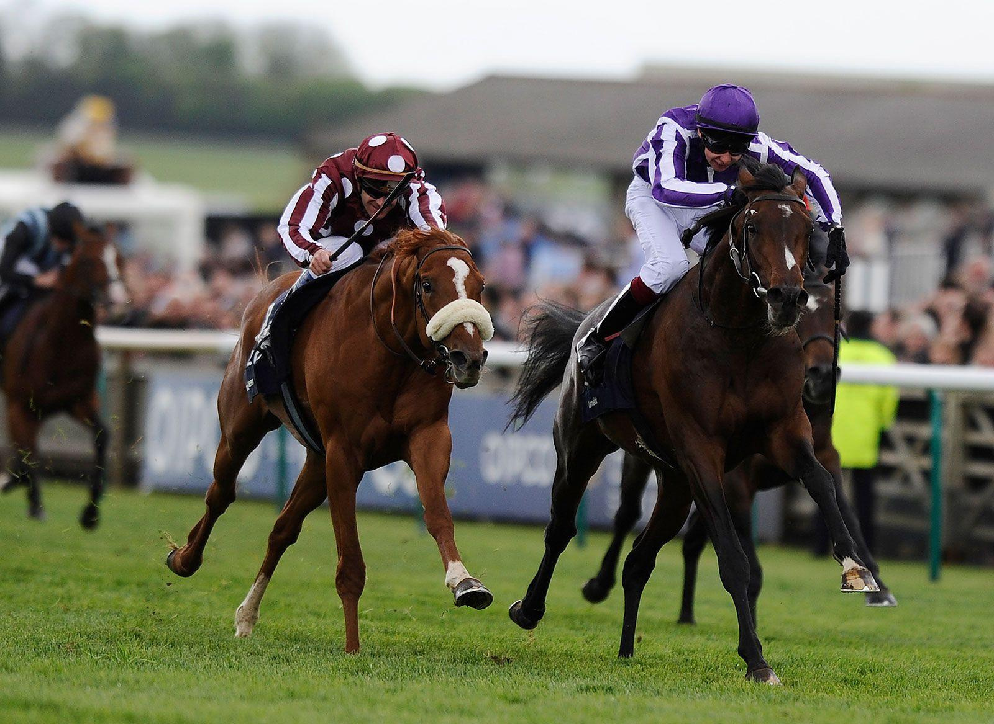
Introduction
The goal of this project is to predict horse racing outcomes (e.g., win or place) using machine learning techniques applied to historical data spanning from 1990 to 2020. Horse racing is known for its complexity and unpredictability, making it an ideal domain for exploring the capabilities of various machine learning models to enhance prediction accuracy.

Slide 3

Modeling Approach and Techniques
The modeling approach involved
Data Cleaning and Processing
Exploratory Data Analysis
selecting appropriate machine learning algorithms.
performing feature selection using methods like Recursive Feature Elimination (RFE) and regularization.
Hyperparameter tuning was conducted using random search.

Slide 4
Problem Statement
Objective of Predicting Horse Racing Outcomes
Challenges of Addressing Unpredictability and Complexity
Importance of Enhancing Prediction Accuracy
The objective is to predict horse racing outcomes, such as which position or place, using historical data. By accurately predicting race outcomes, bettors and stakeholders can make informed decisions.
Horse racing is inherently unpredictable and complex due to various factors like track conditions, jockey skills, horse form, and more. Overcoming these challenges is crucial for accurate predictions.
Enhancing prediction accuracy is vital for bettors and stakeholders who rely on these predictions to make strategic decisions. Accurate predictions can lead to improved betting strategies and increased profitability.

Slide 5
Tools Used
Technologies and Software Used
Machine Learning Algorithms and Techniques Applied
We utilized Python libraries such as Pandas, NumPy, and Scikit-learn for data preprocessing and machine learning. Additionally, data visualization is done to gain insights from the data.
We employed various machine learning algorithms, including regression, random forest, and gradient boosting, catboost and LightGBM to develop predictive models.

Slide 6
Approaches
Data Cleaning: Handled missing values, normalized data (e.g., times, distances), and encoded categorical variables.
Feature Engineering: Created new features such as ‘distance_in_miles’ derived from past races and aggregated features to capture temporal trends.
Data Preprocessing Techniques
Analyzed summary statistics of key features to understand distributions and identify outliers.
Utilized distribution plots to visualize the spread of continuous variables.
Constructed correlation matrices to uncover relationships between features.
Employed scatter plots, histograms, and box plots to visualize data distributions.
Generated pairplots to illustrate correlations and identify potential predictive pattern
.
Exploratory Data Analysis (EDA) Methods

Slide 7
Exploratory Data Analysis (EDA) Findings
Summary statistics of key features helped understand distributions and identify outliers.
Distribution plots visualized the spread of continuous variables.
Correlation matrices uncovered relationships between features.
Scatter plots, histograms, and box plots visualized data distributions.
Pairplots illustrated correlations and identified potential predictive patterns.
Horse's favored position is generally within the top 5 positions.
Position has a negative correlation with distance_in_miles, runners, and TR, and a weak positive correlation with weight and age.

Slide 8

Model Development and Evaluation
Evaluated regression, ensemble methods, nearest neighbors, and advanced techniques.
Used RFE and regularization for feature selection.
Conducted grid and randomized search for hyperparameter optimization.
Utilized MSE, MAE, and R2 to assess model performance.
Achieved MSE of 6.14, MAE of 1.82, and R2 score of 0.70 using catboost regressor.

Slide 9
Conclusion and Suggestions
Key Findings from the Modeling Process
Recommendations for Implementing Optimized Models
Through modeling, significant predictors of race outcomes were identified, providing valuable insights for future predictions and strategic decision-making.
We recommend implementing the optimized models developed through our analysis to make real-time race predictions. These models can provide accurate predictions for bettors and stakeholders.

Slide 10
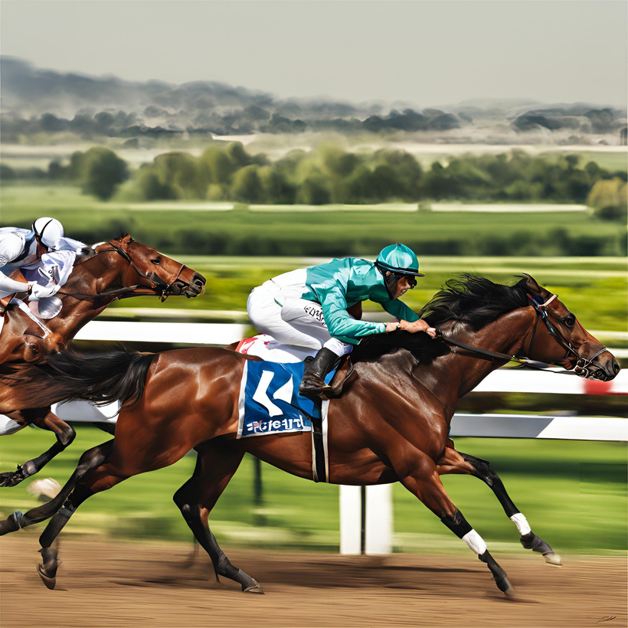
Future Directions for Further Improvement in Predictions
To further improve predictions, exploring advanced techniques like ensemble methods or deep learning can be considered. Continuous research and development can lead to enhanced prediction accuracy and better decision-making in the horse racing industry.

